Slide 1
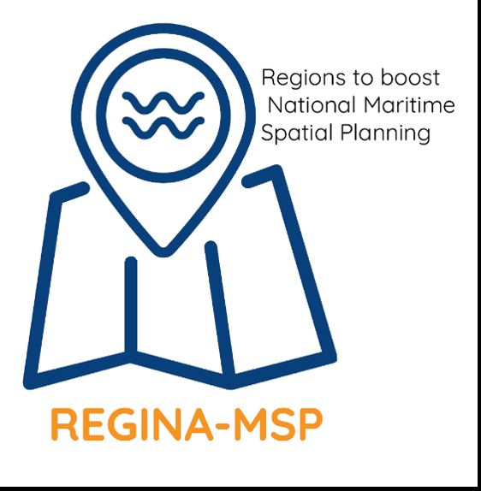
Marine Spatial Planning: an opportunity for transformative practice through the hybridization of land-sea planning traditions?
Céline Jacob, Olivier Laroussinie, Andrea Barbanti, Fabio Carella, Emiliano Ramieri, Martina Bocci, Holly Niner, Elisa Lähde, Mari Pohja-Mykrä
celine.jacob@ifremer.fr

Slide 2
Introduction
European MSP Directive establishing a framework for maritime spatial planning: an opportunity for EU Member States to rethink (strategic) spatial planning
Strategic spatial planning (Albrechts, 2015):
A socio spatial process
A range of people in diverse institutional relations and positions
Designing plan making processes and developing contents and strategies
Towards the management of spatial change
Ministerie Vlaamsee Gemeenshap, 1998
Not directly proposing a solution to the problem but fostering the capacity to promote tools (studies, measures, actions) for a solution
MSP: a process relying on long-established and highly evolved terrestrial spatial planning practices while developing brand-new marine-based planning practices
Hersperger et al., 2018
Notes:
process, institutional design, and mobilisation Albrechts (2015)

Slide 3
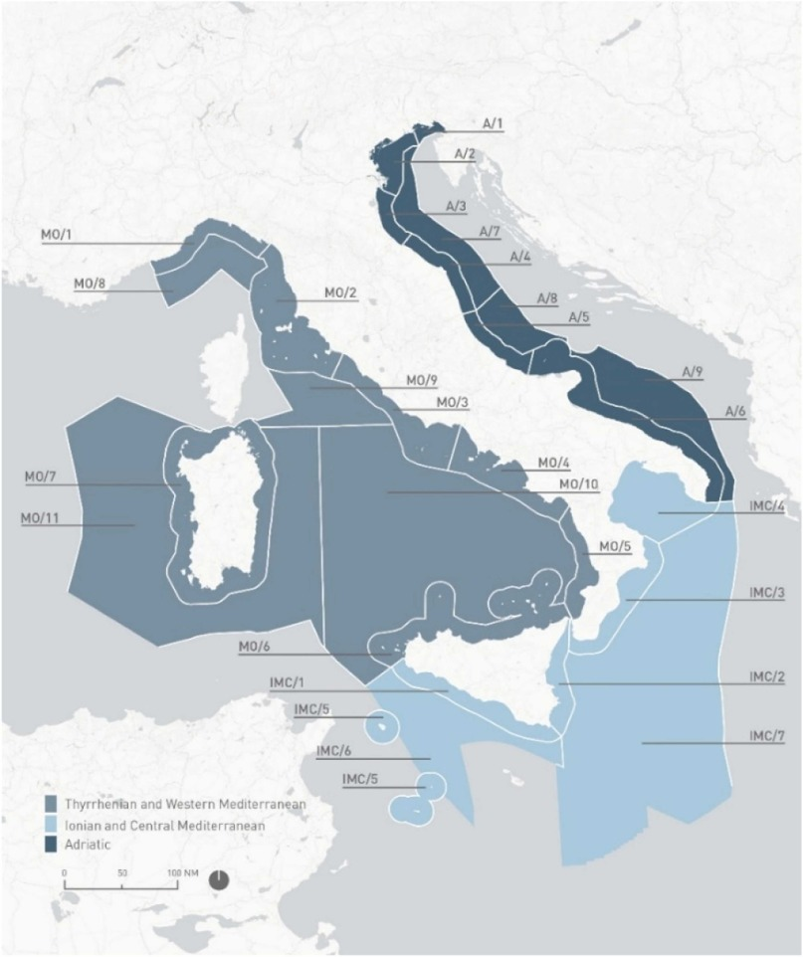
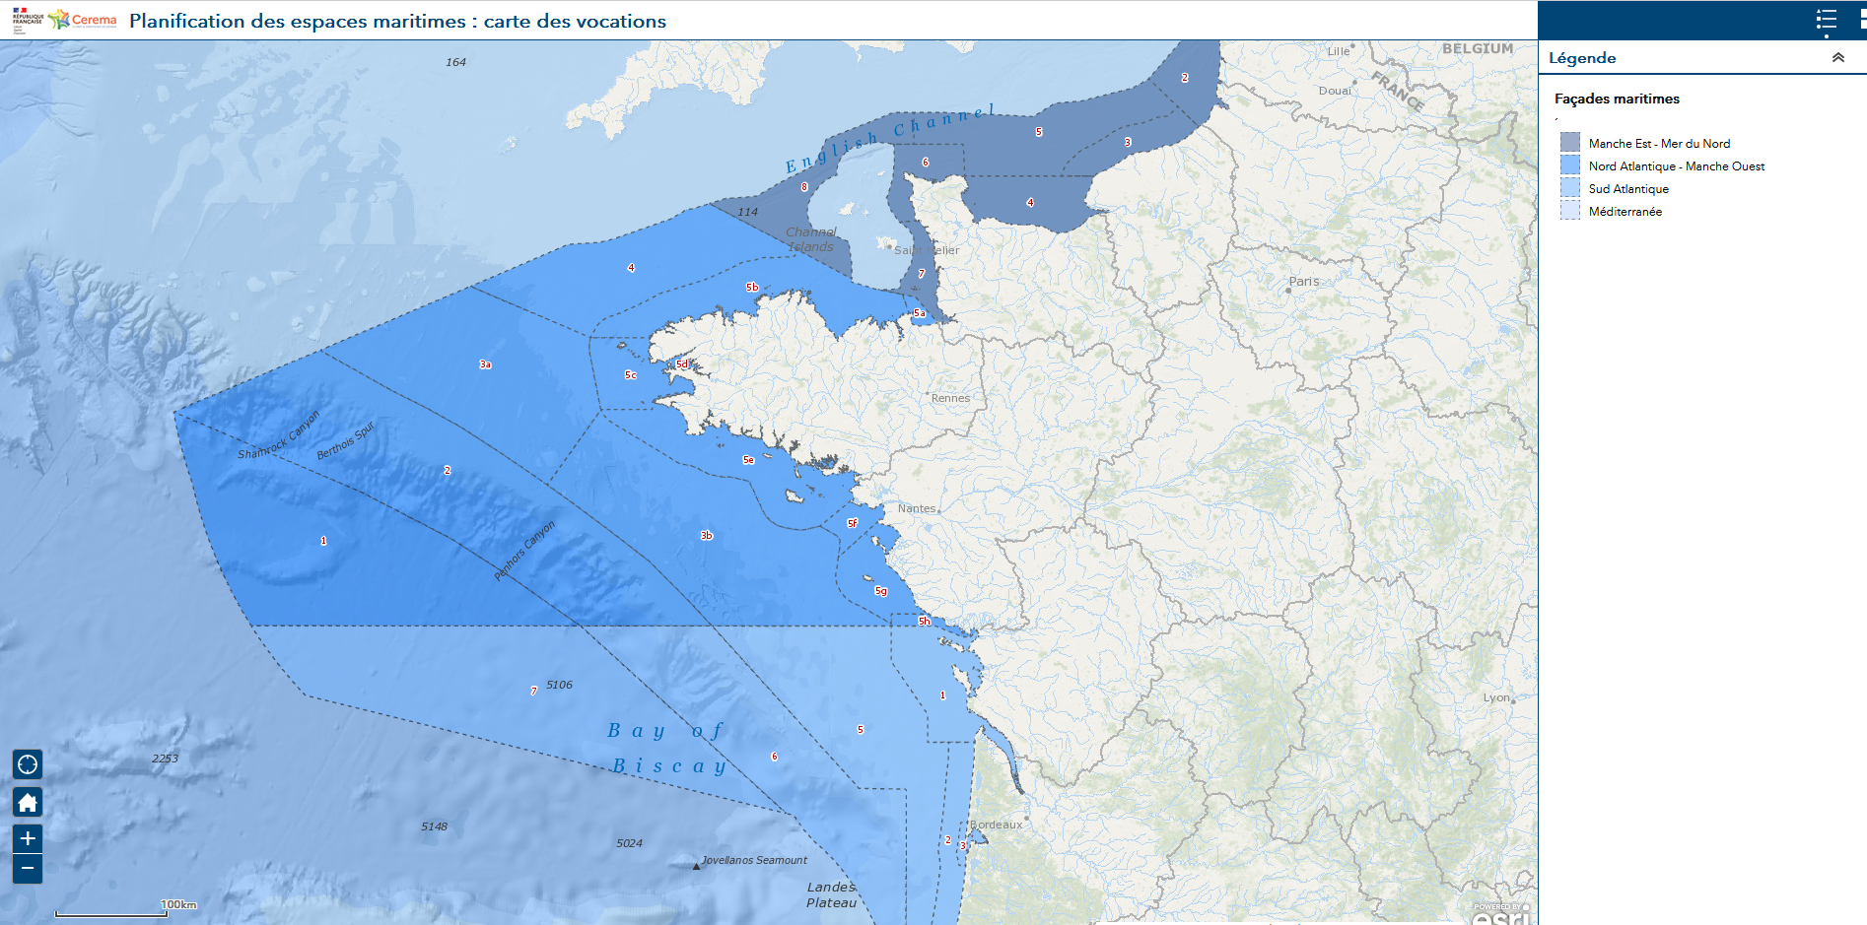
Introduction
Rethinking human-environmental interactions in a context of biodiversity crisis and socio-economic tensions represents a window of opportunity for transformation towards sustainability (Partelow et al., 2023)
Objective of the study:
To investigate if and how the drafting of marine spatial plans contributes to the transformation of strategic spatial planning practices in three European countries: Finland, Italy, and France
Marine plans influence or are influenced by terrestrial spatial plans
Ramieri et al., 2024
Notes:
The uptake of MSP in the context of the biodiversity crisis and socio-economic tensions represents a window of opportunity for transformation towards sustainability "understood as the urgent and intentional change in the composition, structure and/or condition of human-environmental relationships with our oceans, to ensure human well-being, social justice, and environmental stewardship" (Partelow et al., 2023).

Slide 4
Méthode
Institutional capacity defined as the “capacity of organisations to create new relationships for engaging in purposeful, collective action” (Healey, 1998)
3 dimensions (Isaksson and Hagbert 2020)
Knowledge resources | activation of the MSP plan process, including proficiencies of institutions and planners, knowledge of stakeholders involved, and scientific marine knowledge availability
Relational resources | explore the interactions between the different committees, governance bodies, and multidisciplinary teams participating in the marine plans’ drafting and consultation
Mobilisation capacity | can be viewed as a result of what the plans achieved, both in terms of new institutional flow and planning choice to meet MSP targets and how collective action has been promoted
Notes:
Based on the analysis of planning documents and authors’ knowledge, we describe these different aspects in the three countries, highlighting the difference with the terrestrial plans’ processes and pointing out practices that have potential to generate transformative changes.
Case studies are informed by the authors of the study who each have first-hand experience or detailed knowledge of the respective plans of interest through their involvement in marine planning processes or research activities.

Slide 5
Résultats
Who is planning at sea? | Link to their competency at sea Experience of planning at sea or not Direct link to central administration
Which stakeholders are consulted and how? | Different levels of participation (inform-consult-involve-collaborate-empower) Similarities with land-planning consultation but some innovation for marine plans’ elaboration: scope of the consultation, resources involved and material produced, existence of dedicated governance bodies Difference of scales
How the general public is consulted? | Engagement processes of citizens mandatory and can take different forms Real capacitation processes remain scarce More centralized consultation
What is the scope of the marine plans? | Indirect steering impacts as a collaborative tool for spatial planning Harmonizing existing land-use planning plans and sectoral programs Introduction of a new dimension that is maritime
What does “spatial planning” means at sea? | Standards inherited from land planning Planning units: synergies, exclusion, priorities, constrains Difference with land ownership Soft vs hard space
How land-sea interface is addressed? | Theoretical reciprocity or analysis of the continuum Existence of governance body including more stakeholders
Are marine plans science-based? | Breakthrough for marine data/science Research institutions took also an important part in this process and uptake of scientific theories Lack of operationalization of the science produced
Notes:
FIN: Regional councils and municipalities have a right to plan legally binding land-use plans that cover territorial sea area.
Italian regions have administrative competencies for the management of some sectors and uses (e.g. environmental protection, aquaculture, coastal defence) within the 12 nm from the baseline
“hard spaces” considered as clearly defined spatially, legally and institutionally (Purkarthofer, 2016)

Slide 6
Discussion
The transformative effects of knowledge co-production & social learning in planning processes: knowledge resources and relational resources
Maps and data as boundary objects (Smith et al., 2013)
Stakeholders and public engagement processes
Acknowledging the diversity of values and promoting social learning
Co-production approaches & real capacitation
Limits concerning ready-to-use information for decision-makers due to a lack of time, funding or human resources
Notes:
Social learning: This concept is considered as a social process taking place through collective practice, rather than individually and in separate compartments (Burt et al., 2014). Social learning has the ability to generate “new knowledge, shared understanding, trust and, ultimately, collective action” (Lebel et al., 2010).
some innovations can be found in marine plans’ elaboration that facilitate social learning: the scope of the consultation that encompasses a larger audience at national and regional levels, the human and financial resources involved (also linked to the larger scope), the creation of ad hoc consultation bodies that gather key maritime stakeholders, the expertise of stakeholders actively involved in the drafting of plans (the proficiency of planners in both land and sea planning or the involvement of an external scientific team)

Slide 7
Discussion
Some pending questions regarding the mobilisation capacity in relation to spatial fit and multi-level governance
Spatial scales of planning & social practices
Sense of place (Smith, 2011)
Promotion of shared vision
Difference between scales relevant for the expression of social values and environmental governance processes
Importance of multi-level spatial planning
Freepik
Notes:
Sense of place, as a place-based approach, is defined as the subjective perception of people about their environment and their conscious feeling about places (Smith, 2011).
structure inherited from the standards of strategic land planning documents at the core of which is the definition of planning units
scale of stakeholders’ engagement is crucial for a good fit to social practice and for an increased relevance of planning choice
Further implementation of marine plans will inform on choices made regarding spatial fits and links to the local territory

Slide 8
Messages clés
3 ingredients towards transformability
New (but still perfectible) ways of co-producing knowledge
using science-based approaches, acknowledging the diversity of values and promoting social learning
1
Promotion of relational resources
engaging with various stakeholders and organising discussions based on new methodological approaches
2
3
Some uncertainties regarding plans’ capacity to promote new institutional flow and collective action enabling change and transformation capacity

